Slide 1
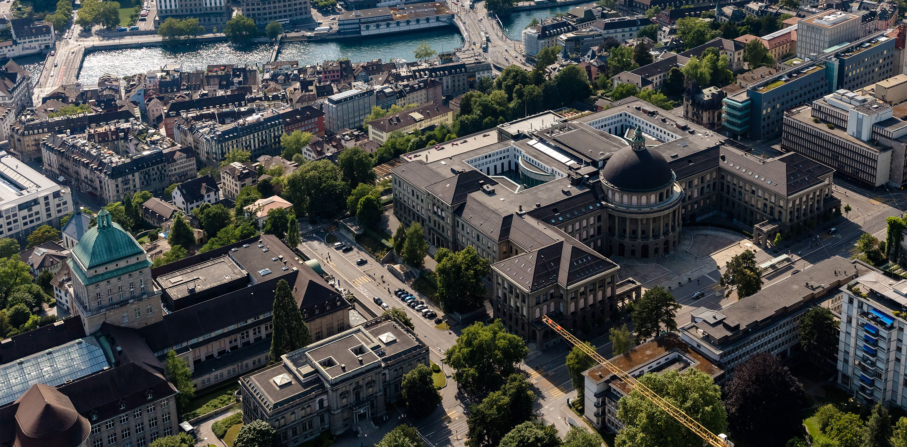

Carbon Dioxide to 1-Propanol Weekly Update
Institute for Chemical and Bioengineering
Sustainable Process Systems Engineering Lab
Abhinandan Nabera
06. July 2022

Slide 2
Meeting Minutes (28.06.2022)
Comparison of the end points and GWP of four evaluation stages
Equilibrium calculations (without recycle)
Flowsheet from literature
(with utilities)
Flowsheet from literature
(without utilities)
Stoichiometric calculations

Slide 3
Meeting Minutes (28.06.2022)
Carbon dioxide route is environmentally better almost always
Shift the focus to economics
Try to simulate the flowsheet with the available data (to get the BAU contributions)
Sensitivity analysis for the prices of raw materials, electricity to find the cut-off where this process is feasible
Come up with an idea to integrate with other processes (e.g. Alexei Lapkin ethylene paper)

Slide 4
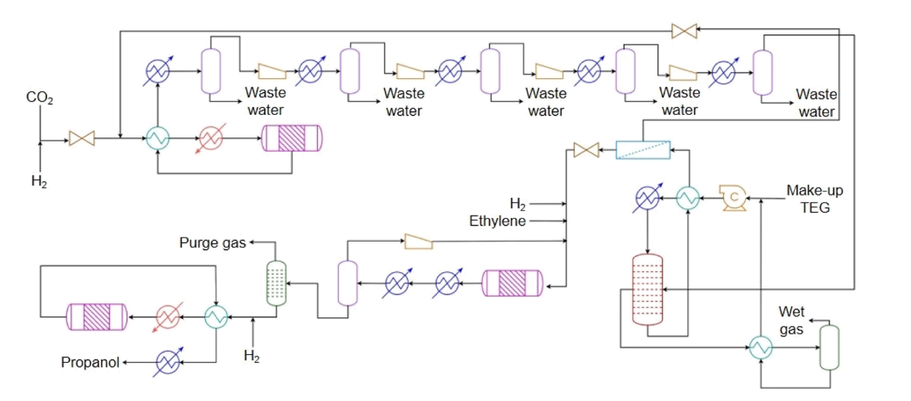

BAU vs Proposed Route
Main reactions
RWGS: ${CO}_{2}+ H_{2}→ CO+ H_{2}O$
Hydroformylation: $C_{2}H_{4}+CO+ H_{2}→ {CH}_{3}{CH}_{2}CHO$
Hydrogenation: ${CH}_{3}{CH}_{2}CHO+ H_{2}→ {CH}_{3}{CH}_{2}{CH}_{2}OH$
Side reactions
Hydroformylation: $C_{2}H_{4}+H_{2}→ C_{2}H_{6}$
Essentially the same
Only difference is
BAU: syngas from steam reforming
Proposed route: syngas from carbon dioxide
Proposed Method
RWGS
Hydrogenation
Hydroformylation
BAU
Syngas from SMR

Slide 5
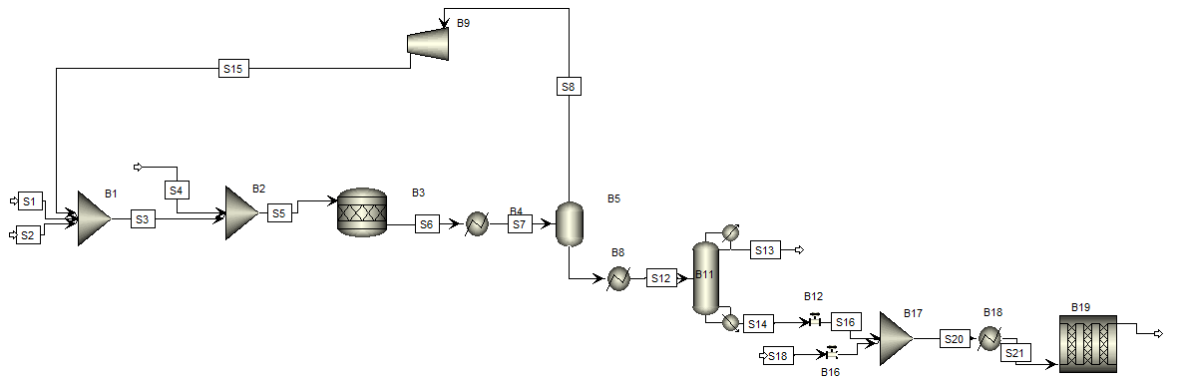
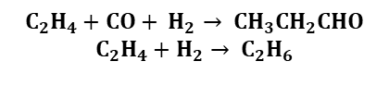

Simulation (Syngas to 1-Propanol)
Hydroformylation
$$C_{2}H_{4}+CO+ H_{2}→ {CH}_{3}{CH}_{2}CHO$$
$$C_{2}H_{4}+H_{2}→ C_{2}H_{6}$$
Hydrogenation
$${CH}_{3}{CH}_{2}CHO+ H_{2}→ {CH}_{3}{CH}_{2}{CH}_{2}OH$$

Slide 6
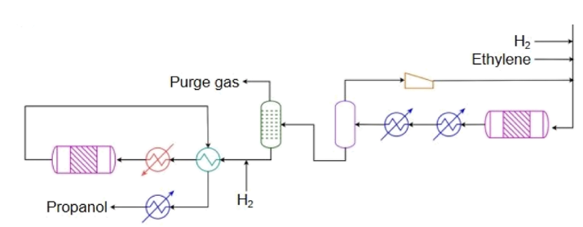

Challenges
Not enough data for the separation process e.g. CO stripper after the hydroformylation reactor
Difference in the purge gas composition reported and calculated
Energy required for compression and separation found to be very different (because the flow rates are different)
CO
Hydrogenation
Hydroformylation
$$C_{2}H_{4}+CO+ H_{2}→ {CH}_{3}{CH}_{2}CHO$$
$$C_{2}H_{4}+H_{2}→ C_{2}H_{6}$$
$${CH}_{3}{CH}_{2}CHO+ H_{2}→ {CH}_{3}{CH}_{2}{CH}_{2}OH$$
CO stripper

Slide 7
Differences
Step | Reported value | Calculated value | % difference
Compressor – B9 (kJ/hr) | 197,441.95 | 40,072,631.76 | + 20196
CO₂ emissions – S13 (Mt/a) | 0.290 | 0.231 | - 20.34
Condenser duty – B11 (kJ/hr) | 52,741,568.80 | 6,500,870.93 | - 87.67
Reboiler duty – B11 (kJ/hr) | 84,956,768.97 | 18,921,626.96 | - 77.73

Slide 8
Path Forward
Complete and optimize the flowsheet for the BAU process
Simulate the complete flowsheet for the proposed process from scratch
Calculate the economics of both the BAU and the proposed process
Find break even prices of raw materials (e.g. carbon dioxide, hydrogen, ethylene, green-ethylene etc.)

